Slide 1

Defining a Field, a School and a Curriculum
Walk Around Get to Know Each Other – 5 Minutes
Brian Wright
brianwright@virginia.edu

Slide 2
Brian Wright Assistant Professor Director for Undergrad Programs University of Virginia PhD: Higher Education Administration Economics, Public Policy Founded the DS Program at GWU Founded the DSI at GWU Founded(ing) UVA’s Undergraduate Programs Chief Data Scientist – Small Consultancy Worked in Defense Consulting for 10 years Board Member for DC Data Community – 30k Members

Slide 3
Data Science Degree for the Data Age

Slide 4
Data Age?

Slide 5
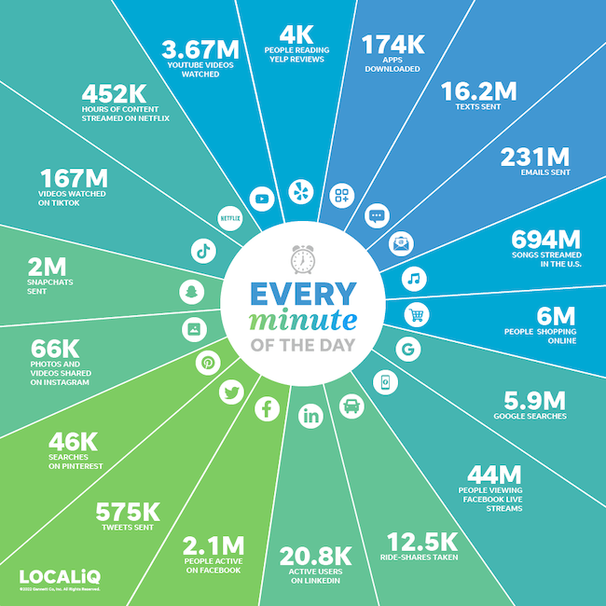
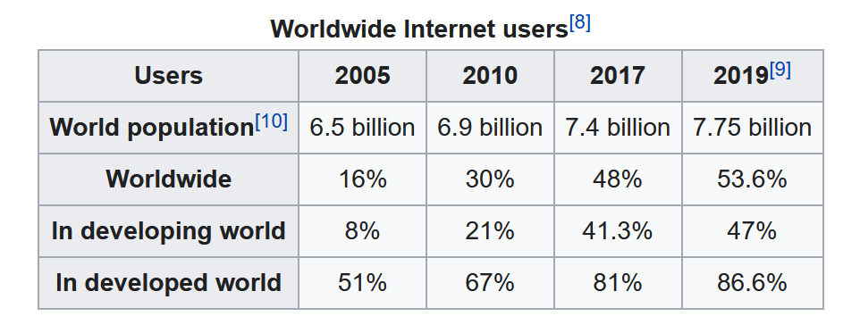
4 Billion social media users
Internet Users Table:
Source: International Telecommunications Union (Agency of the UN)
Only one source…
?

Slide 6
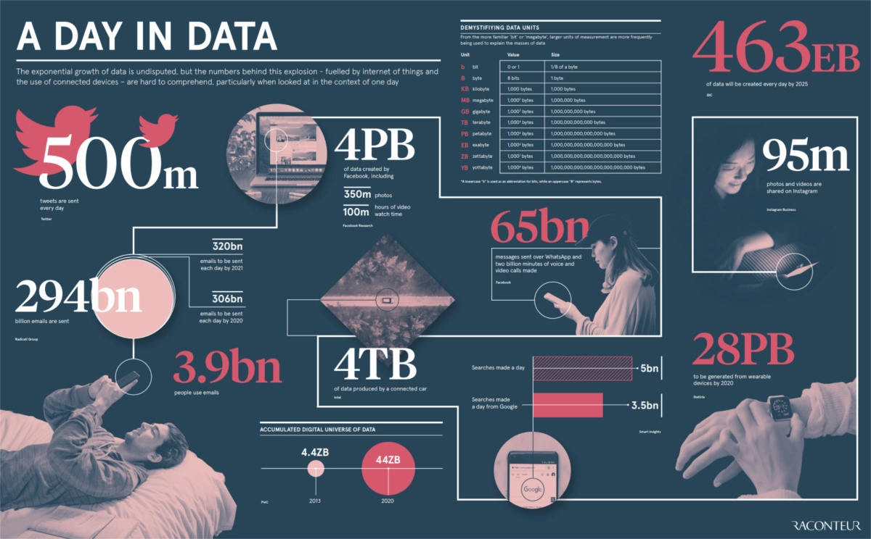
https://www.qwant.com/?client=ext-firefox-sb&t=images&q=normal+distribution&o=0%3A0867C7A9CC1F9B31D9BB2B0D06B41B90CECAFC90
Source: https://www.visualcapitalist.com/how-much-data-is-generated-each-day/

Slide 7
Ok so lots of data but…..
more importantly our lives are being driven by this data and the algorithms that feed on it.

Slide 8
Machine Learning Bias and Social Science Methods
YouTube
In 2021 YouTube crossed a milestone on hours watched per day….guess?
Equivalent to ~137,000 years, every day!

Slide 9
Machine Learning Bias and Social Science Methods
YouTube
In roughly 2011-12 switch their model to hours watched from clicks
Brought in Google Brain to train the Deep Neural Network to make the video recommendations
Result was similar videos got recommended…but often resulted in gradually getting more and more extreme content, regardless of the topic and a lack of diverse topics…jogger to ultra marathon
Why?

Slide 10
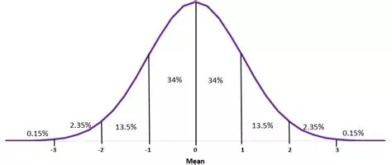
Machine Learning Bias and Social Science Methods
Machine Learning detected the pattern and optimized for it, its that simple.
Also, a perfect feeder system to how our brains interact information…
Source: https://www.qwant.com/?client=ext-firefox-sb&t=images&q=normal+distribution&o=0%3A0867C7A9CC1F9B31D9BB2B0D06B41B90CECAFC90

Slide 11
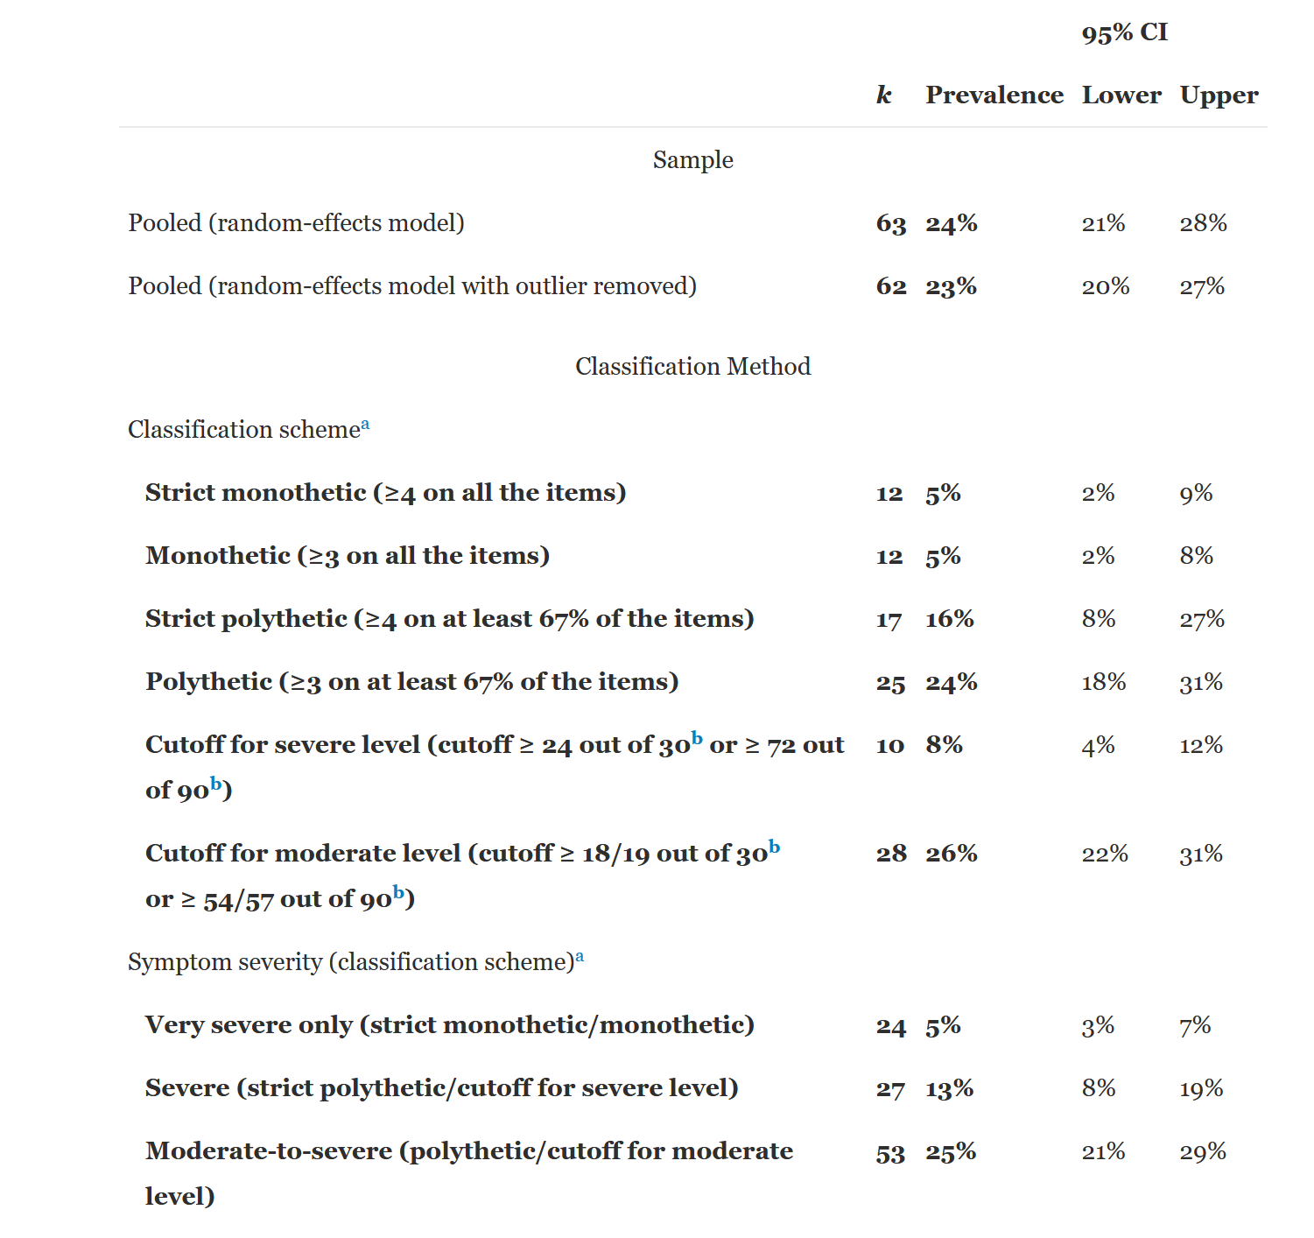
Meta-Analysis
50 Studies
37,798 individuals
Mean age – 24
Gender – 56% Female
July 2020 – 4 Billion user of Social Media
2 billion on Facebook
Very Severe – 200 Million
Severe – 520 Million
Moderate to Severe – 1 billion
Almost half of all social media user could be moderately to severely addicted
Source: Cecilia Cheng, Yan-ching Lau, Linus Chan, Jeremy W. Luk,
Prevalence of social media addiction across 32 nations: Meta-analysis with subgroup analysis of classification schemes and cultural values, Addictive Behaviors, Volume 117, 2021, 106845, ISSN 0306-4603, https://doi.org/10.1016/j.addbeh.2021.106845

Slide 12
What else can go wrong….well

Slide 13
Machine Learning Bias and Social Science Methods: Examples
Algos gone bad:
Google’s Cloud Natural Language API was launched in 2016. In fall of 2017 Andrew Thompson from Motherboard Inc. experimented with the tool and discovered bias results.
“I’m Christian” had positive results but, “I’m a Jew” and “I’m a gay black woman” resulted in negative results.
Trained on news and social media data

Slide 14
Machine Learning Bias and Social Science Methods: Examples
From Google: “We dedicate a lot of effort to making sure the NLP API avoids bias, but we don’t always get it right. This is an example of one of those times, and we are sorry.” ☹

Slide 15
Machine Learning Bias and Social Science Methods: Examples
Example:
Amazon Recruiting Engine
Used an AI tool to give candidates a score from one to five stars based on resumes.
“They (Amazon) literally wanted it to be an engine where I’m going to give you 100 resumes, and it will spit out the top five, and we’ll hire those.”
The problem was that data was used from 10 years of hiring that was mostly men, so the ML tool systematically scored women lower
Amazon just this year abandoned the project because it couldn’t be proven reliable.

Slide 16
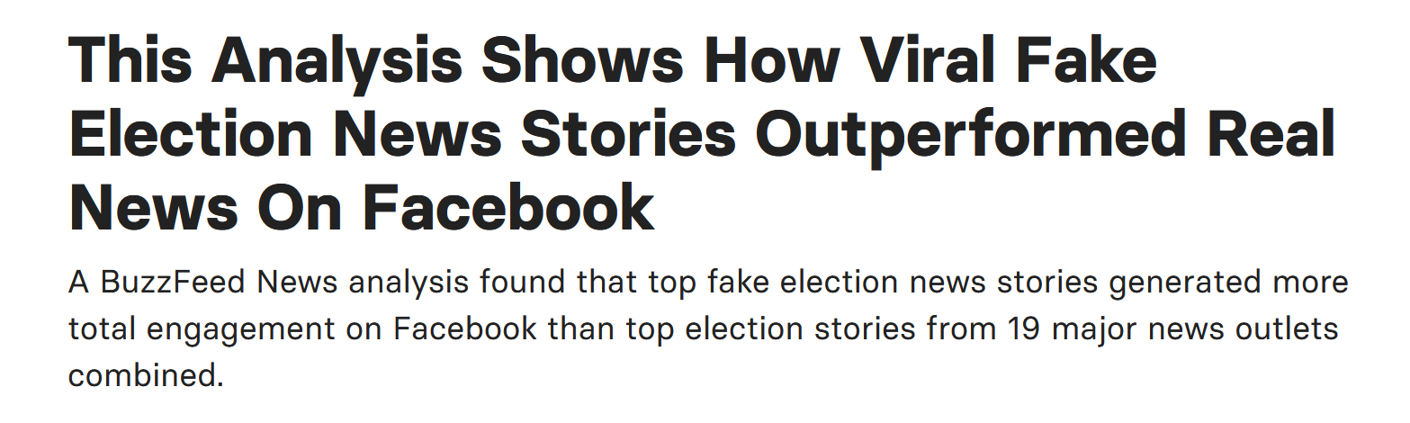
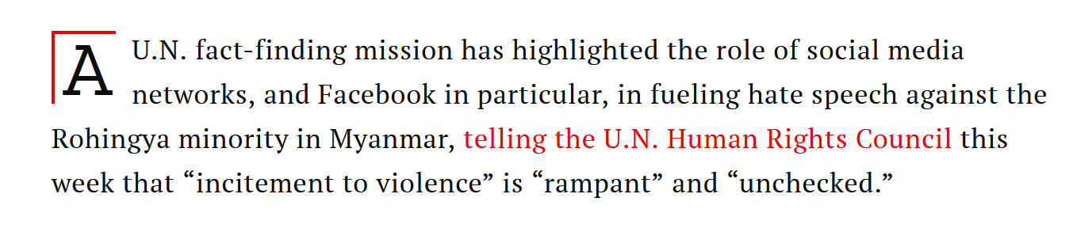
Machine Learning Bias and Social Science Methods: Examples
Facebook
Spread of Fake News
source: https://www.buzzfeednews.com/article/craigsilverman/viral-fake-election-news-outperformed-real-news-on-facebook
Myanmar Genocide
Source: Time.com

Slide 17
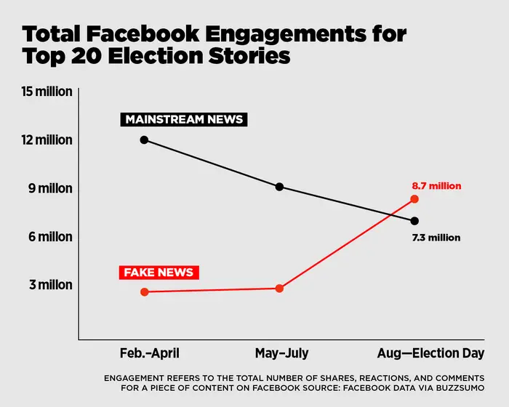

Slide 18
Data Literacy = Digital Society Literacy

Slide 19
Modern Economy

Slide 20
Knowledge Economy?
A system of consumption and production that is predicated on intellectual capital
Intellectual Capital?
The value of a company or organization's employee knowledge, business training and any proprietary information that may provide the company with a competitive advantage.
What is driving this economic reality?
Notes:
What does know economy mean to you guys? How about intellectual capital? So if we believe are moving towards a knowledge economy predicated on intellectual capital what does that mean for the working individual and what is driving this reality?

Slide 21
Adam Smith in 1776 prognosticated in Wealth of Nations that Division of Labor would be a economic driver for years to come and he was right, resulting in….
Occurs as an economy becomes more and more advanced requiring ever increasing specialized skills.
Hyper-Specialization?
Notes:
Division of labor occurs as a economy becomes more and more advanced require ever increasing specialized skills.

Slide 22
Knowledge Economy
What Does this Mean for us?
Hyper Specialization
Intellectual Capital
Division of Labor
It means that a combination of technical proficiency and subject area expertise will be essential for success. Both of which can be facilitated with UVA’s model for a DS degree

Slide 23
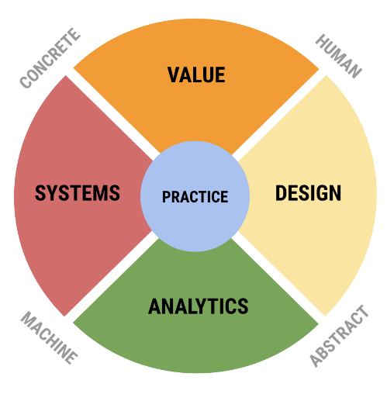
SDS View on Data Science
“Liberal Arts Degree for the Data Age”
UVA SDS needed not just pipeline/process but a conceptual model of field. Rafael Alavardo created this framework of the field.

Slide 24
Practice
This area consists of actual activities that brings people together to combine expertise from each of the four areas. It is characterized by data science teams working together and with external parties to develop solutions and projects that are responsible, authentic, effective, and efficient.
Working to develop a dozen or more external concentration that students can pursue – examples neuroscience, digital humanities, forecasting and educational analytics.
This is a non-trivial departure from most current undergraduate models.
Research experiences will be provided throughout the 3 years
Develop pathways into applied graduate programs

Slide 25
Design
Human machine interaction as it appears at the points of both consuming data and producing data products. Activities here include the representation and communication of human reality as data for the work of analytics, e.g. in database design, the curation of data, and of complex data and analytical results to humans to drive decision-making and influence behavior.
Key tensions: discovery vs product, user-facing vs analyst-facing.
Common theme: Communication.
Keywords: communication, design thinking, representation, use interface, communication, visualization, visual and object languages, informatics, ontology, curation, HCI, informating, data product design, data discovery.
Values: openness, authenticity, beauty, form and function.

Slide 26
Value
Combines the traditional discipline of ethics with the professional activities of business planning, policy making, developing motivations for scientific research, and other activities that have a direct impact on people and the planet.
Key tensions: enterprise vs ethics, private interest vs public good (see Plato’s Republic).
Common theme: human value.
Keywords: ethics, justice, wealth, value, social good, motivation, meaning,
Values: responsibility, diversity, inclusion, flourishing, excellence
Ref: Digital Epidemiology

Slide 27
Human Capital versus Market Signaling

Slide 28
Signaling
Human Capital

Slide 29
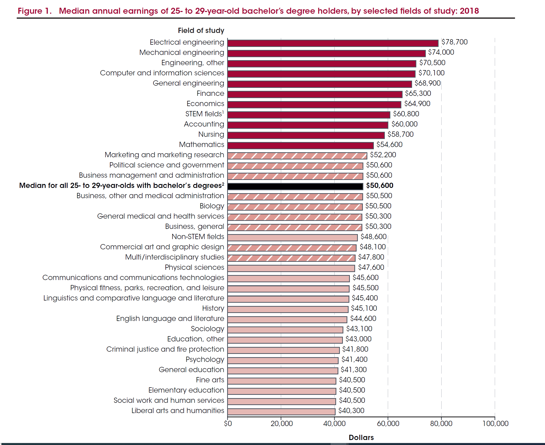

Slide 30
Problem Solving through Probabilistic Reasoning
High level – Two types of reasoning
Type 1 - “…autonomous because their execution is rapid and mandatory when the triggering stimuli are encountered, they do not require much cognitive effort, and they can operate in parallel (Chiesi,Primi, & Morsanyi, 315). ”
People feel they are correct, but they are often wrong and misleading even if the human brain reinforces this reactions as correct, via some automated response mechanism
Type 2 “…processes are relatively slow and computationally expensive, they are available for conscious awareness, serial, and often language based (Chiesi,Primi, & Morsanyi, 315).”
The use of heuristics that facilitate type 1 reasoning increases over time.
Sources: Francesca Chiesi , Caterina Primi & Kinga Morsanyi (2011) Developmental changes in probabilistic reasoning: The role of cognitive capacity, instructions, thinking styles, and relevant knowledge, Thinking & Reasoning, 17:3, 315-350, DOI: 10.1080/13546783.2011.598401

Slide 31
Summary
Focus on Problem Solving through Probabilistic Reasoning
Maximizes both Human Capital and Signaling Educational Theories
Creates a foundation for Market Sector Specialization – Knowledge Economy
Data Literate Society is Required for the Data Age

Slide 32
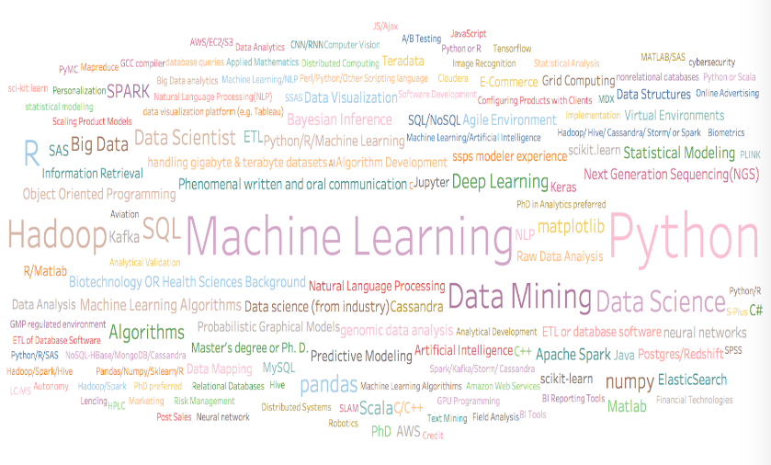
Based on 200 “Data Scientist” jobs national wide, expanding the number to included thousands of jobs targeting DC area, NYC, and Silicon Valley

Slide 33
Systems
Infrastructure systems and architectures to support working with big data — big in terms of volume, velocity, and variety — and building high performance pipelines in both development and production environments. It includes the broad areas of hardware and software (programming) as such — computer technology as opposed to computer science.
Key tensions: development vs production, volume vs speed.
Common theme: building
Keywords: infrastructure, data systems, data engineering, the cloud, networks, hardware, software, programming languages, big data management, benchmarking, continuous integration, availability, cybersecurity.
Values: speed, stability, robustness, resilience, uptime.

Slide 34
Analytics
Analytics includes what most consider to be the heart of data science, the combination of statistical methods with machine learning, along with optimization, signal processing, network analysis, and other rigorous quantitative methods from a variety of fields.
Key tensions: inference vs prediction, analysis vs simulation.
Common theme: Mathematical models and methods.
Keywords: prediction, inference, machine learning, statistics, operations research, AI, experimental design, causality, optimization, knowledge, models, feature engineering, data mining.
Values: accuracy, precision, validity, truth, convergence, explainability.

Slide 35
Mapping of Categories
Data description and Curation Design
Mathematical Foundations Analytics
Computational Thinking Design and Analytics
Statistical Thinking Analytics
Data Modeling Design
Communication, reproducibility, and ethics Design, Value

